Slide 1
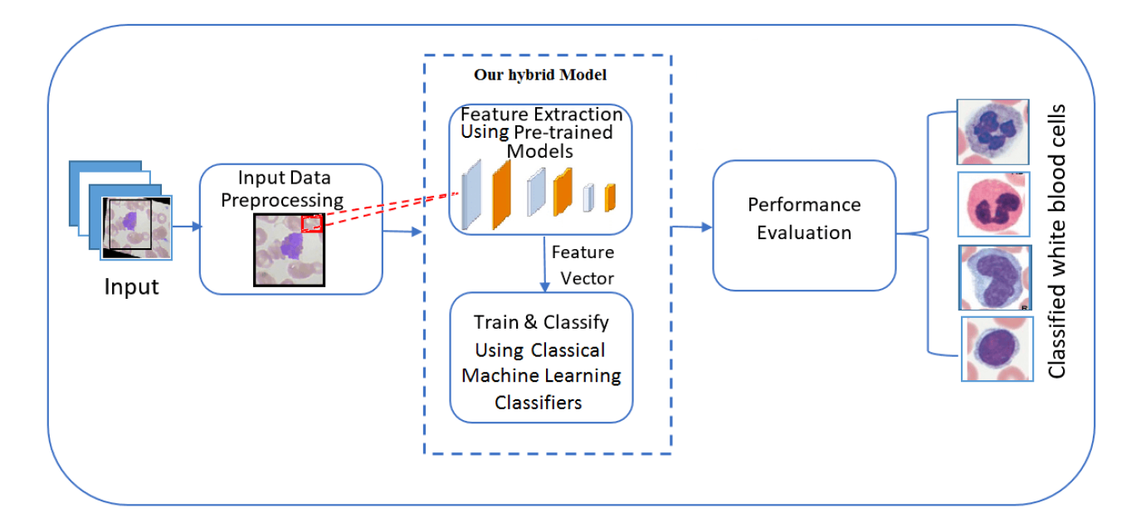
Architecture used
We used MobileNet version 1 for feature extraction.
And Logistic regression for classification.

Slide 2
Dataset Details
Image Blood Cells
The dataset contains 12500 images with dimensions of 320*240 pixels each. The images are classified into only four classes: eosinophil, lymphocyte, monocyte and neutrophil. Each class has approximately 3120 images -2500 for training and 620 for testing.
Rabin WBC
The dataset contains 10830 images with dimensions of 575*575 pixels each. The images are classified into only four classes: eosinophil, lymphocyte, monocyte and neutrophil. Each class has approximately 2000 images -2500 for training and 800 for testing

Slide 3
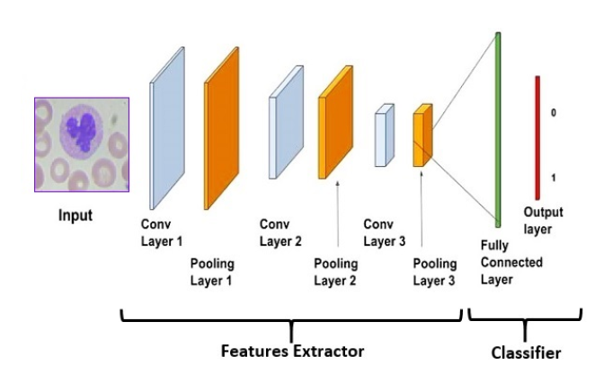
Implementation Details
1. In Data pre-processing:
We resize each image to 224*224 image and centralized the WBC.
Drop any image have two WBC because we found out some images have two WBC sometimes are in the same kind and sometimes it is not.
2. In model implementation:
We implement MobileNet model to make feature extraction only. And get the features vector.
We implement logistic regression model and pass the features vector to the model.

Slide 4
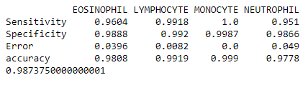
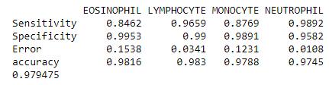
Results
For Image Blood Cells dataset
For Rabin dataset

